Slide 1


SIDDHARTHA INSTITUTE OF ENGINEERING & TECHNOLOGY
(Accredited by NBA, NAAC, Approved by AICTE & Affiliated to JNTUH)
Vinobha Nagar, Ibrahimpatnam, Ranga Reddy Dist – 501 506, Telangana
COMPUTER SCIENCE & ENGINEERING
INDUSTRIAL ORIENTED MINI PROJECT
G.Vyshnavi
G. Rajeev Reddy
J Mallikarjun
B. Harshal
22TP1A0545
22TP1A0539
22TP1A0561
22TP1A0516
Guided by:
Mr. G Uday Kumar (M. Tech)
Assistant Professor

Slide 2

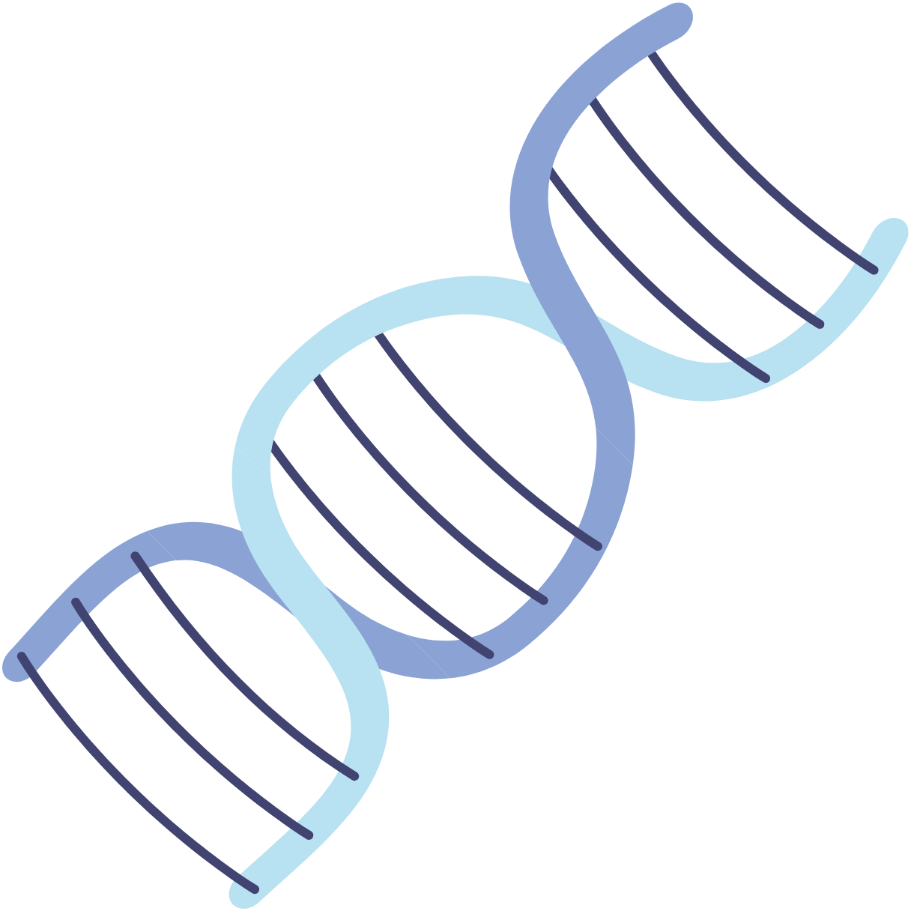
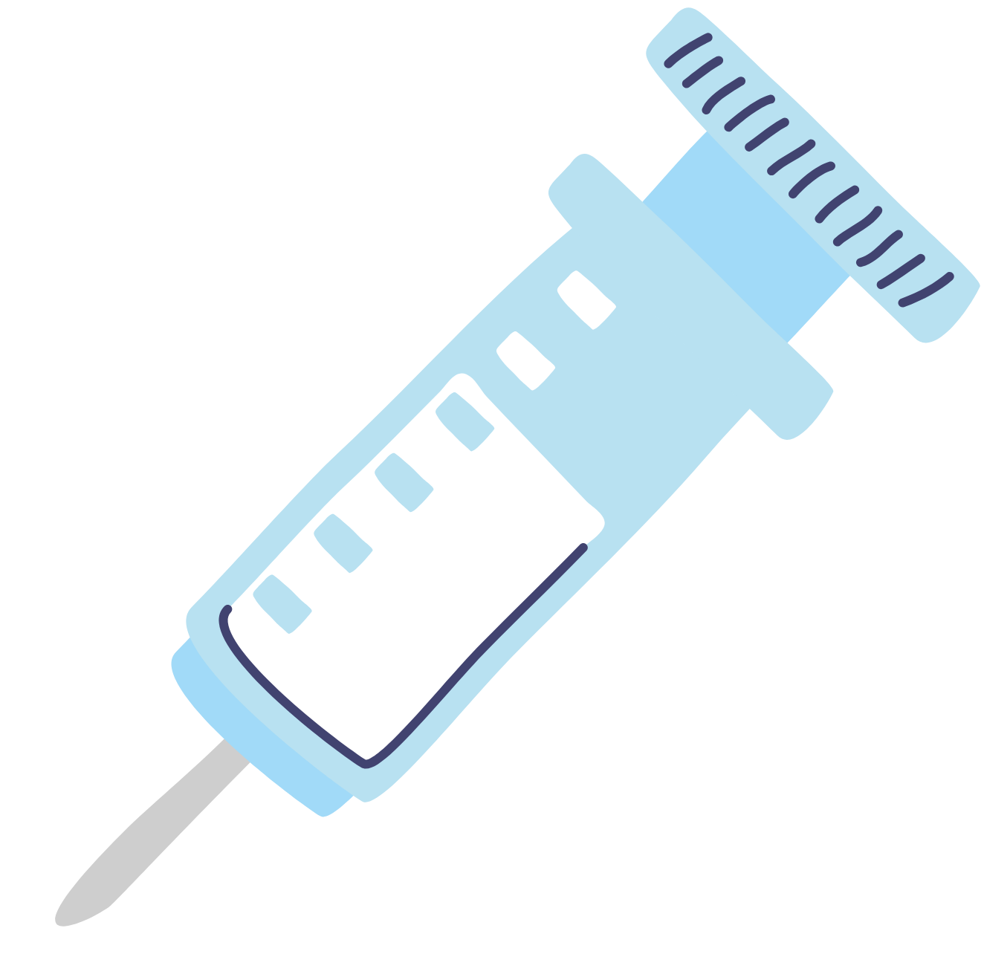

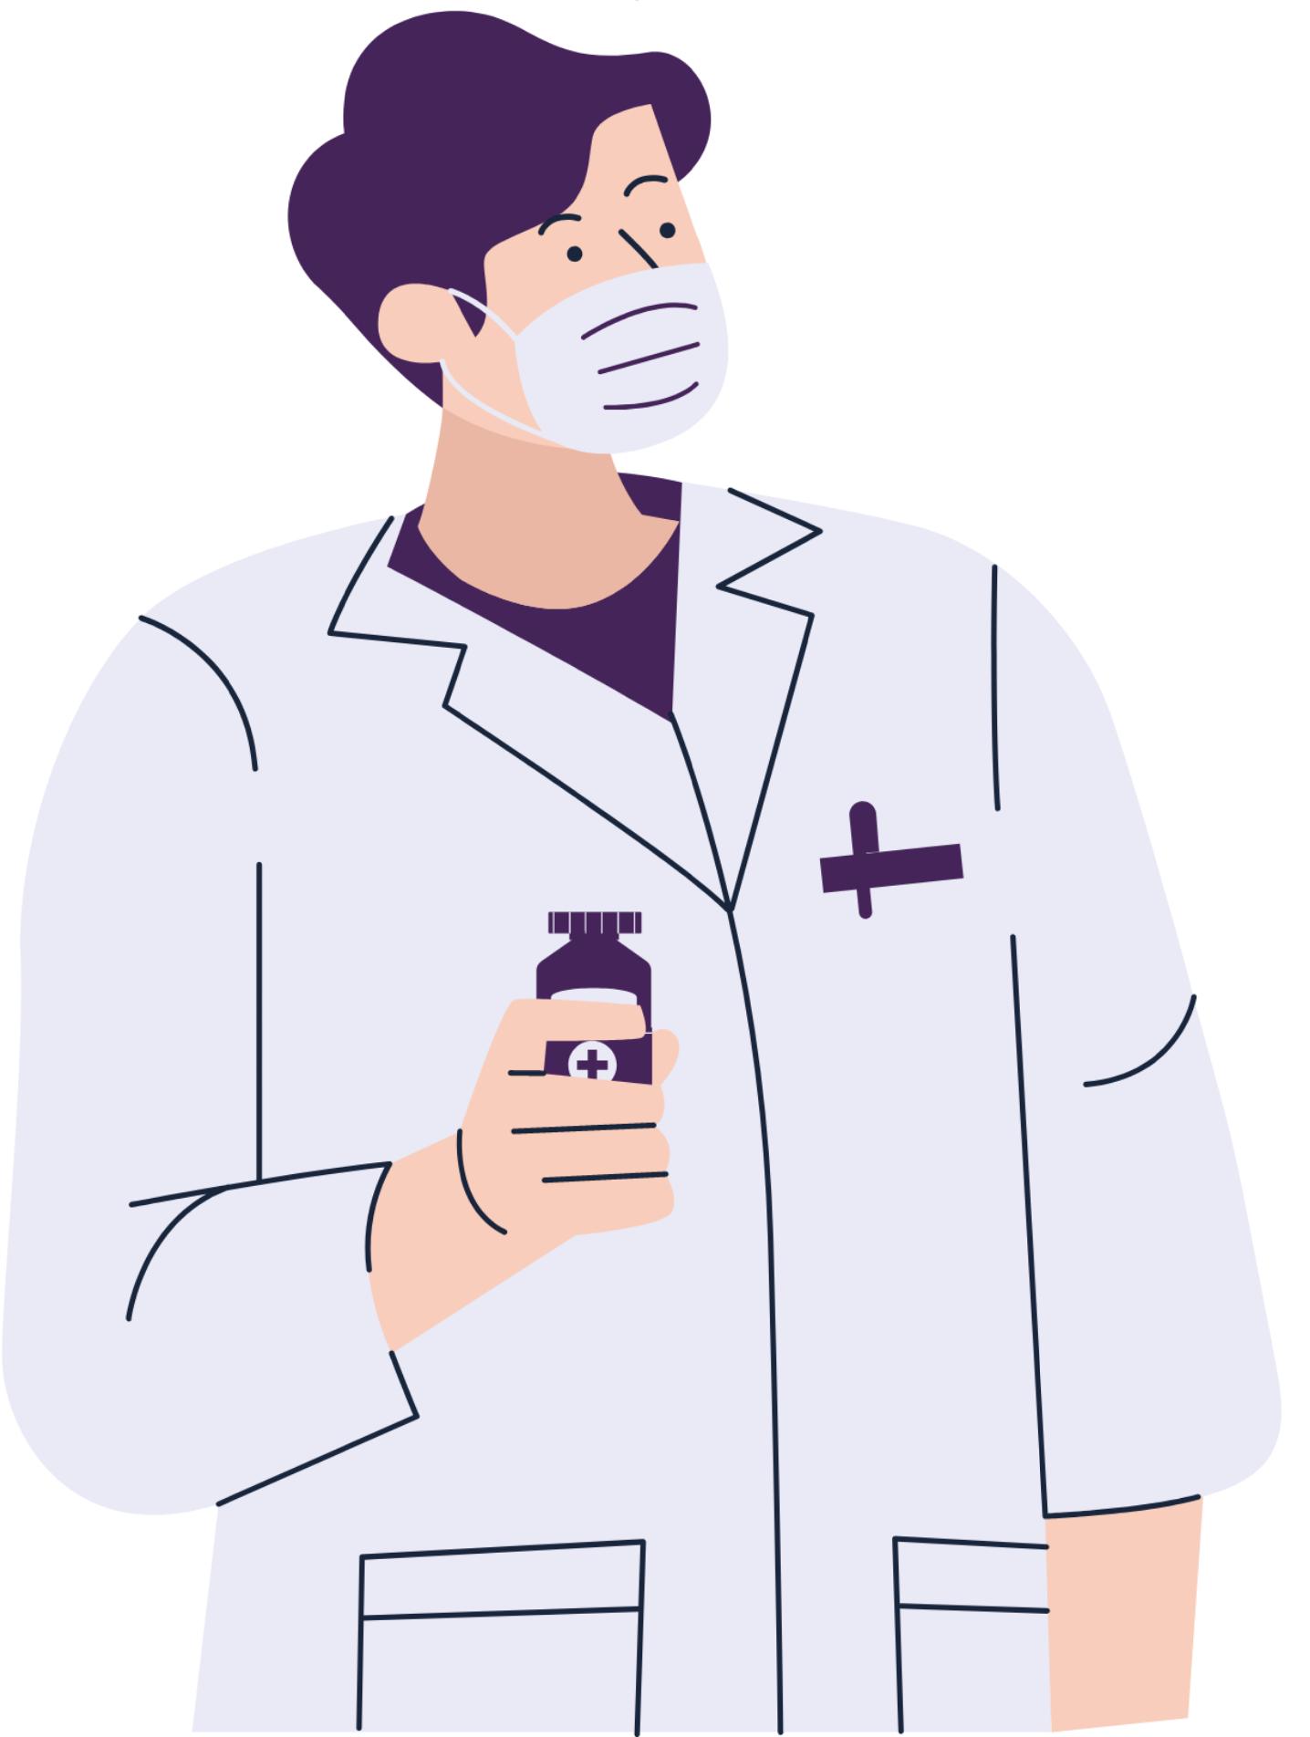

Predicting Chronic Kidney Diseases Using Machine Learning
Machine learning helps predict chronic kidney disease by analyzing patient data to find early signs of kidney problems. This allows doctors to diagnose and treat the condition sooner, improving health outcomes.

Slide 3

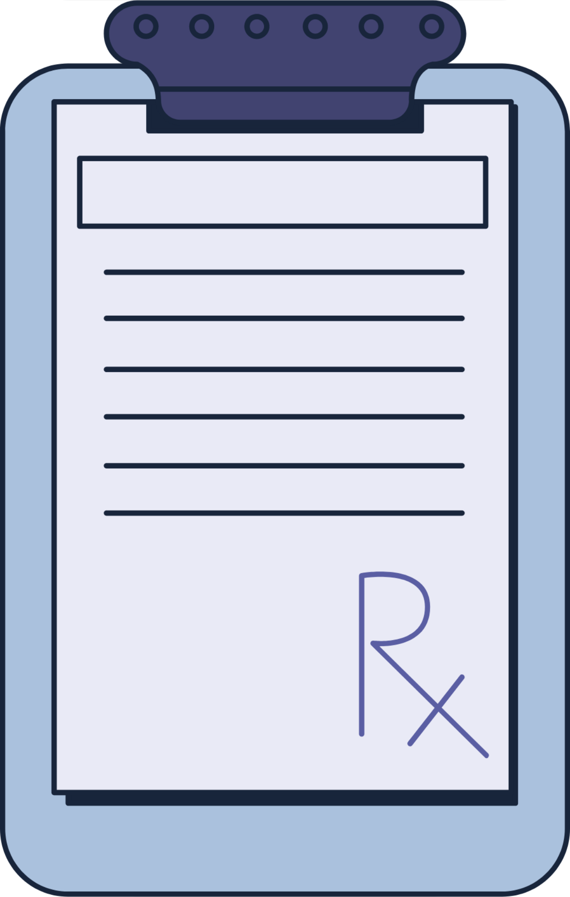
AGENDA
System Design
Developement Tool
Implementation
Software Testing
Applications
Conclusions
Abstract
Introduction
Objective
Existing System
Proposed System
Project Description
Requirements

Slide 4
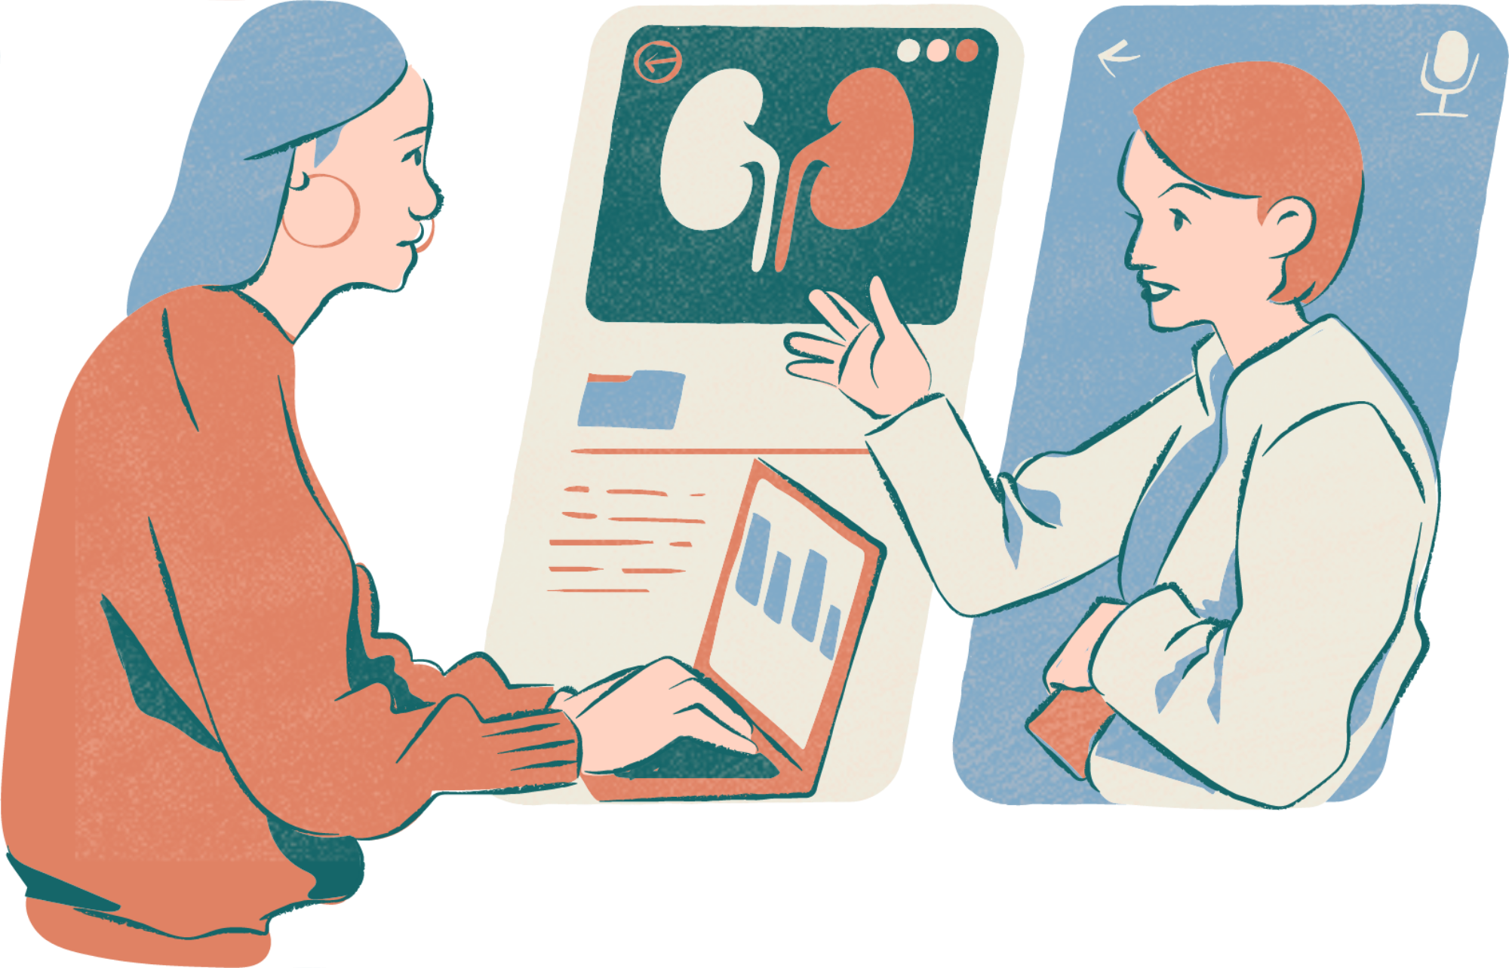

ABSTRACT
This project aims to predict renal health conditions using a Decision Tree (DT) machine learning model. Early detection of kidney issues is critical, and our system helps by assessing health attributes such as Age, Blood Pressure (Bp), Serum Urea (Su), Hemoglobin (Hemo), Blood Glucose Ratio (BGR), and others.
The model offers:
High interpretability
Accurate and fast prediction
User-friendly interface

Slide 5
INTRODUCTION
Kidney health is vital to overall well-being, and early detection can greatly improve treatment outcomes.
Users input key health data such as Age, Blood Pressure, Serum Urea, Red Blood Cells, and Hemoglobin, and the model predicts whether the kidney is at risk.
Compared to traditional methods like Logistic Regression and SVM, the DT model offers:
Higher accuracy (99%)
Better interpretability
Simple and clear result
This system supports early diagnosis and offers a quick,
user-friendly way to monitor kidney health.

Slide 6
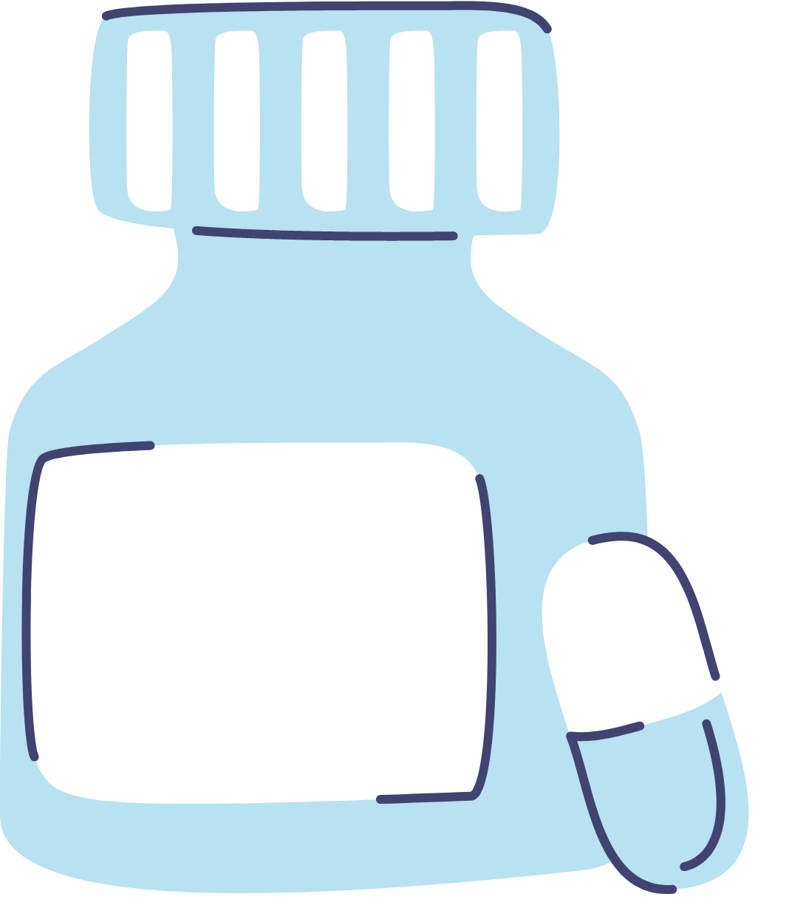
OBJECTIVE
Objective 01
Objective 02
Efficient and Accurate Kidney Health Prediction – The system utilizes the Decision Tree (DT) algorithm to assess renal health risks based on key medical parameters.
Early Diagnosis and Intervention – Helps individuals receive timely medical attention before kidney conditions worsen, promoting proactive healthcare.
Objective 03
Objective 04
Improved Precision Over Traditional Methods – DT surpasses Logistic Regression and SVM in accuracy and interpretability, ensuring more reliable classification results
User-Friendly and Accessible Monitoring Designed for healthcare professionals and individuals, providing a fast and automated way to track kidney health.

Slide 7
EXISTING SYSTEM
In the past, systems used Logistic Regression and Support Vector Machines (SVM) to predict kidney problems.
Logistic Regression is good for simple, straight-line data.
But kidney health is complex and not always linear, so it doesn’t work very well here.
SVM can handle more complex data,
But it takes a lot of time to set up (parameter tuning)
Also, it’s hard for doctors to understand how it makes decisions
DISADVANTAGES
Less accurate results
Takes more time to process
Difficult to understand and explain predictions

Slide 8

PROPOSED SYSTEM
The proposed system uses Machine Learning, specifically the Decision Tree (DT) algorithm, to predict renal health conditions based on user-input data like age, blood pressure, serum urea, red blood cells, and hemoglobin. Trained on a large dataset, the DT model achieves 99% accuracy, offering a reliable, efficient, and user-friendly tool for early detection and proactive healthcare.

Slide 9
PROJECT DESCRIPTION
Data Gathering and Cleaning
Key Feature Identification and Analysis
Decision Tree Model Building
Model Testing and Accuracy Evaluation
User Interface Design and Deployment

Slide 10
Description 01
Description 02
Data Gathering and Cleaning
Collect raw data from reliable sources and clean it by handling missing values, duplicates, and errors to ensure quality input for the model.
Key Feature Identification and Analysis
Select the most important health indicators (like age, blood pressure, etc.) and analyze their impact on kidney health using statistical and visual tools.
Description 03
Decision Tree Model Building
Train a Decision Tree classifier using the processed data. The model learns patterns to classify whether the kidney is in danger or not.

Slide 11
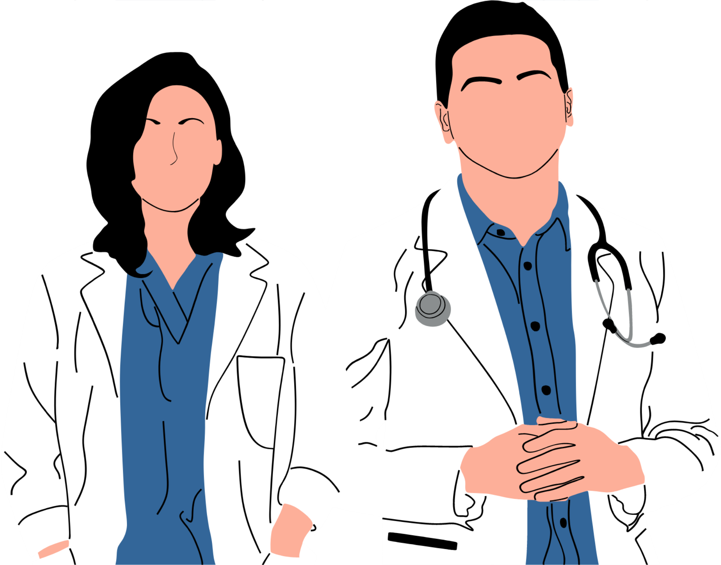
Description 04
Model Testing and Accuracy Evaluation
Evaluate the model’s performance using metrics like accuracy, precision, and recall to ensure it gives reliable predictions.
Description 05
User Interface Design and Deployment
Develop a simple, user-friendly interface (web/app) where users can input their health data and instantly get a prediction.

Slide 12
SOFTWARE REQUIREMENTS
REQUIREMENTS
HARDWARE REQUIREMENTS
· PROCESSOR : DUAL CORE 2 DUOS.
· RAM : 4GB DD RAM
· HARD DISK : 250 GB
Requirements Engineering is a crucial part of any software or machine learning project. It involves identifying, analyzing, documenting, and managing the needs of stakeholders to ensure the successful development of the system.
Operating System
Platform
Programming
Front-End
Windows 7/8/10
Spyder3
Python
Spyder3

Slide 13
FUNCTIONAL REQUIREMENTS
NON-FUNCTIONAL REQUIREMENTS
(What the system should do)
(How the system should perform)
User Input Form
Collects user data (e.g., Age, Blood Pressure, Serum Urea, Hemoglobin, etc.).
Accuracy
The model must provide a minimum of 95-99% accuracy on prediction tasks.
Data Preprocessing
Cleans, normalizes, and prepares input data for prediction.
Performance
Predictions should be generated in under 2 seconds for user inputs.
Prediction Engine
Uses the trained Decision Tree model to predict kidney condition:
Output: "Kidney in Danger" or "Kidney Not in Danger"
Security & Privacy
User medical data must be protected and not shared or stored insecurely.
Scalability
The system should allow more data/features to be added in the future without major redesign.
User Interface (Web/App)
A simple interface for data input and result viewing.

Slide 14
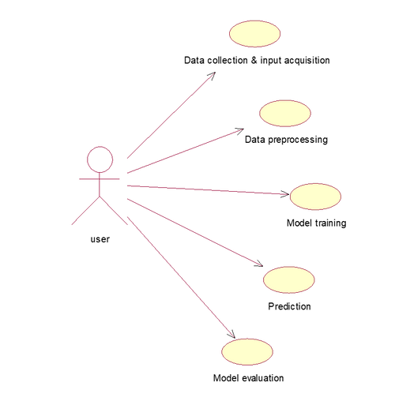
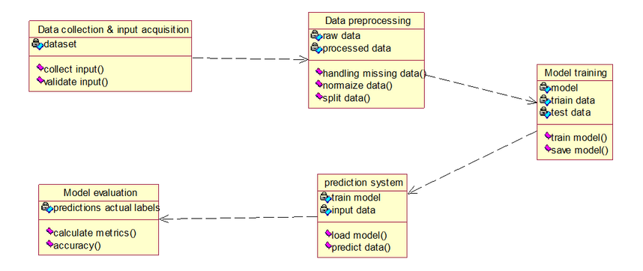
SYSTEM DESIGN
Design Engineering deals with the various UML [Unified Modelling language] diagrams for the implementation of project. Design is a meaningful engineering representation of a thing that is to be built. Software design is a process through which the requirements are translated into representation of the software.
1 . USE CASE DIAGRAM
2 . CLASS DIAGRAM

Slide 15
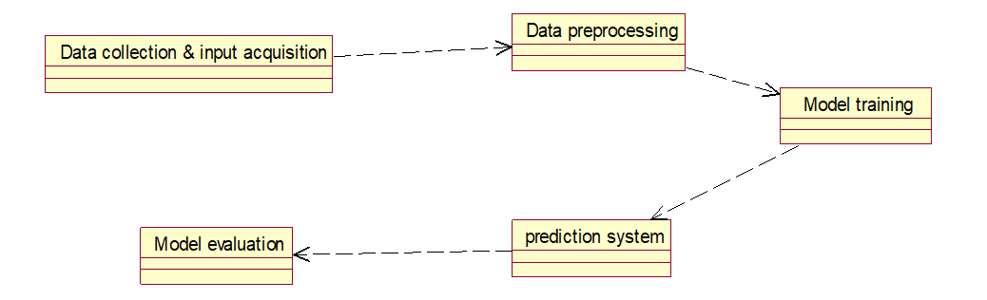
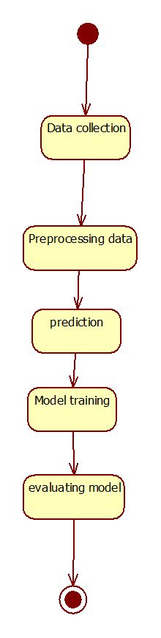
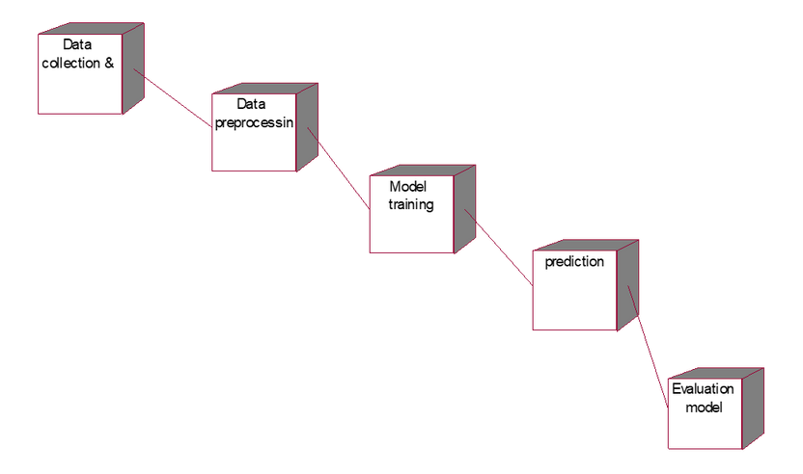
3.OBJECT DIAGRAM
4.STATE DIAGRAM
5.DEPLOYMENT DIAGRAM

Slide 16
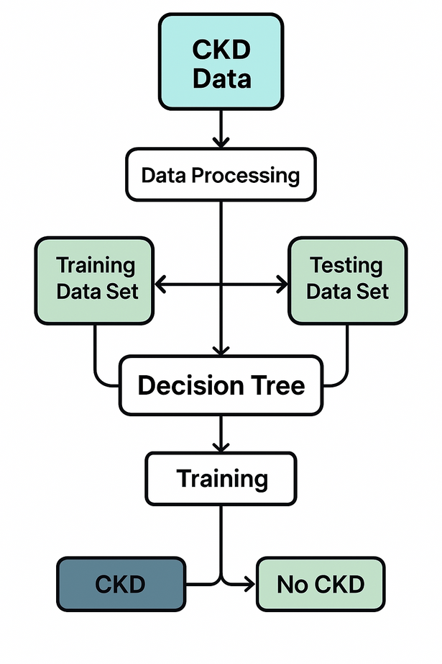
System Architecture

Slide 17

DEVELOPEMENT TOOL
Python is a high-level, versatile programming language known for its clean syntax and readability. Created by Guido van Rossum and first released in 1991,
It’s widely used in areas like:
Web development (with frameworks like Django and Flask)
Data science and machine learning (using libraries like Pandas, NumPy, TensorFlow, and Scikit-learn)
Automation and scripting
Software development and APIs
Cybersecurity and DevOps
Features :
Easy-to-learn
Easy-to-read
A broad standard library
Portable
Databases
Scalable

Slide 18
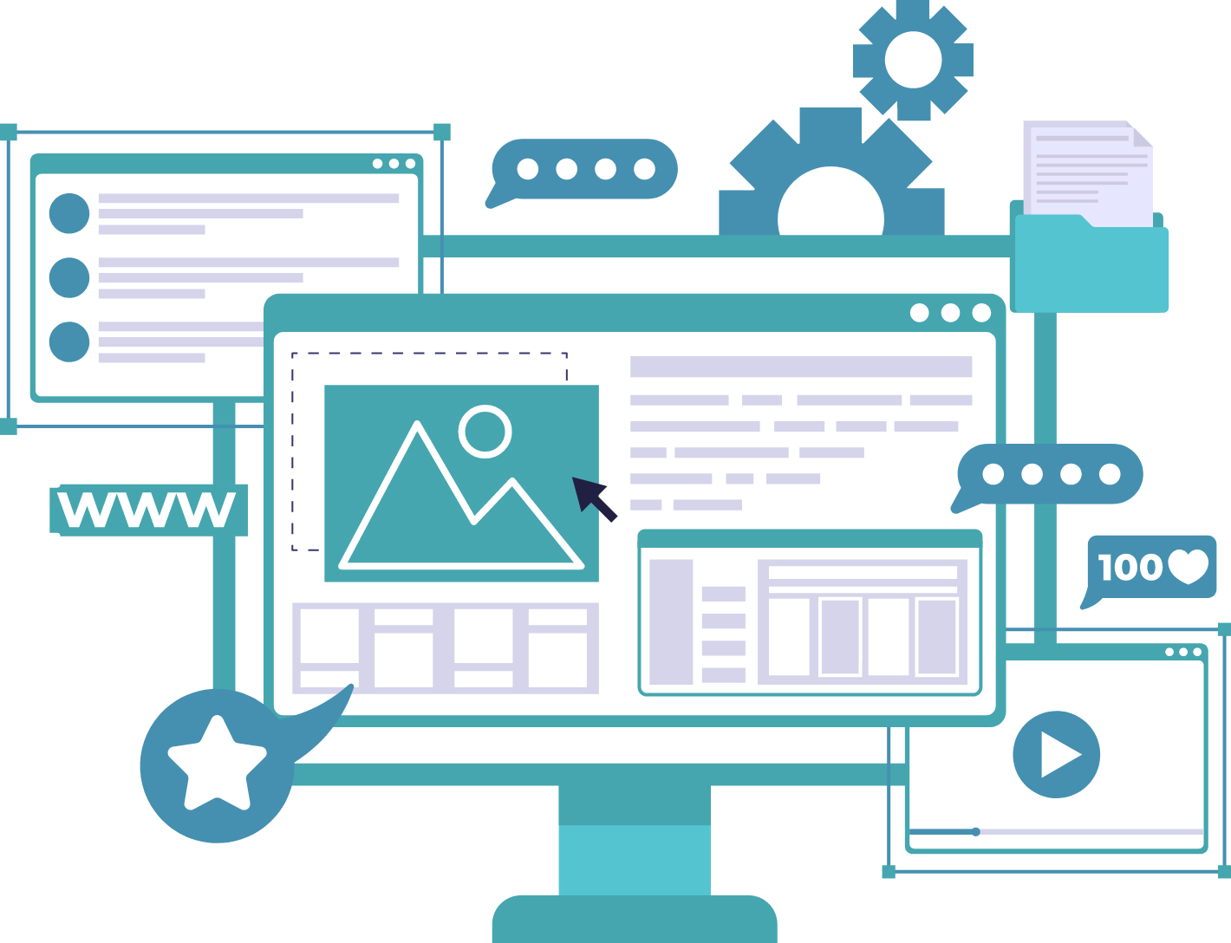
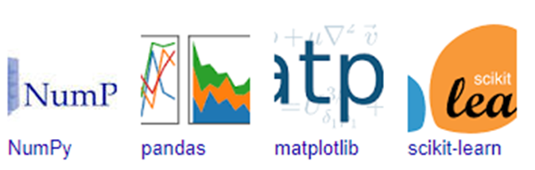
Libraries used in python
NumPy - Mainly useful for its N-dimensional array objects.
Pandas - Python data analysis library, including structures such as data frames.
Matplotlib - 2D plotting library producing publication quality figures.
Scikit - Machine learning algorithms used for data analysis and data mining tasks.

Slide 19
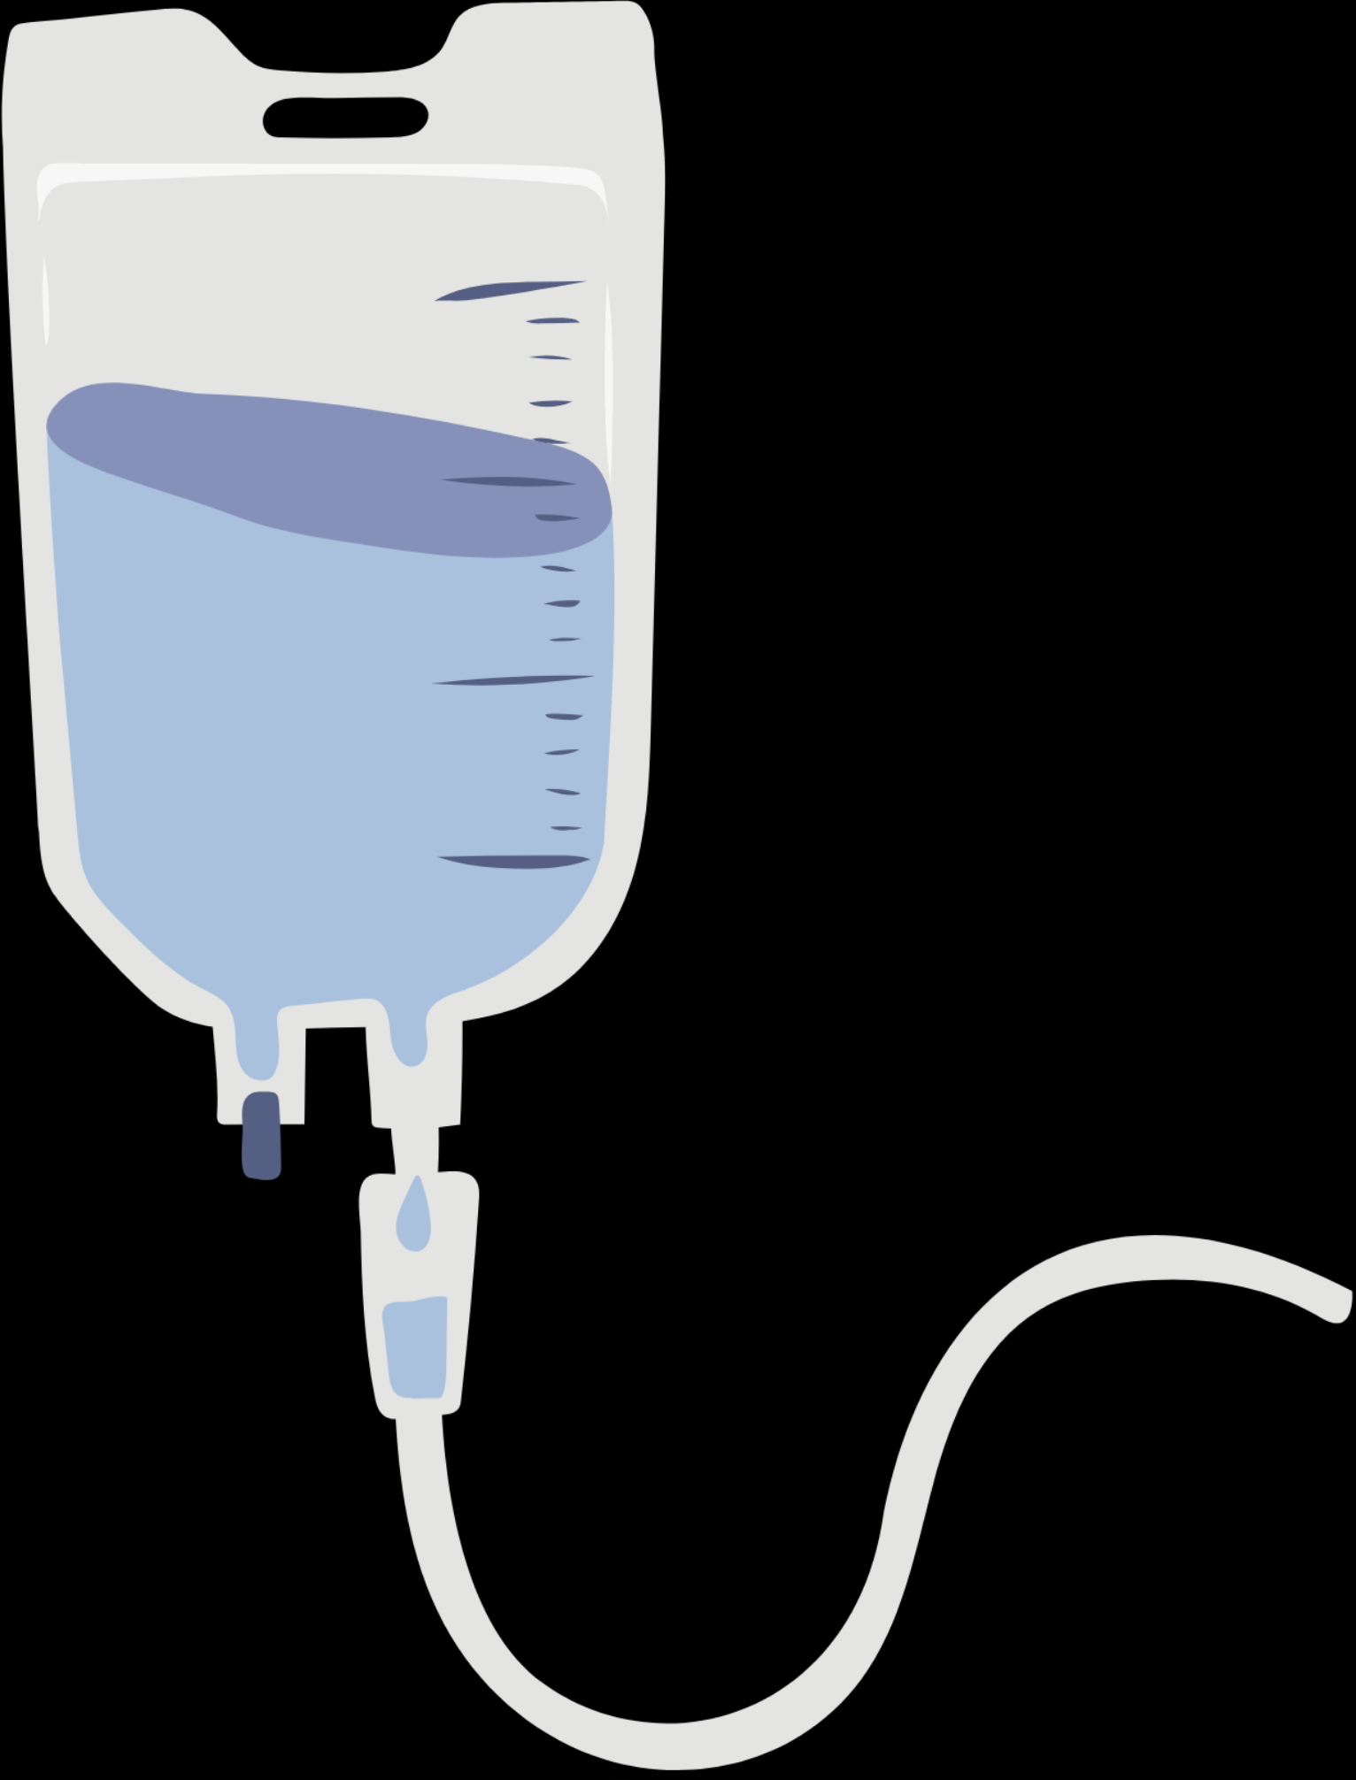
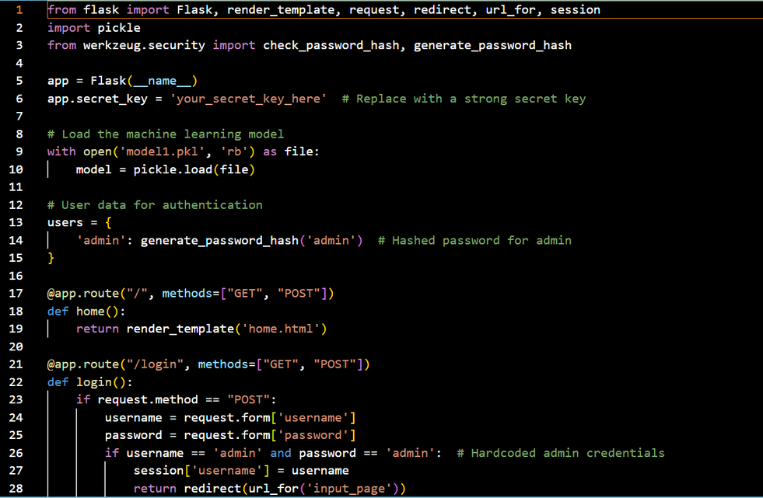
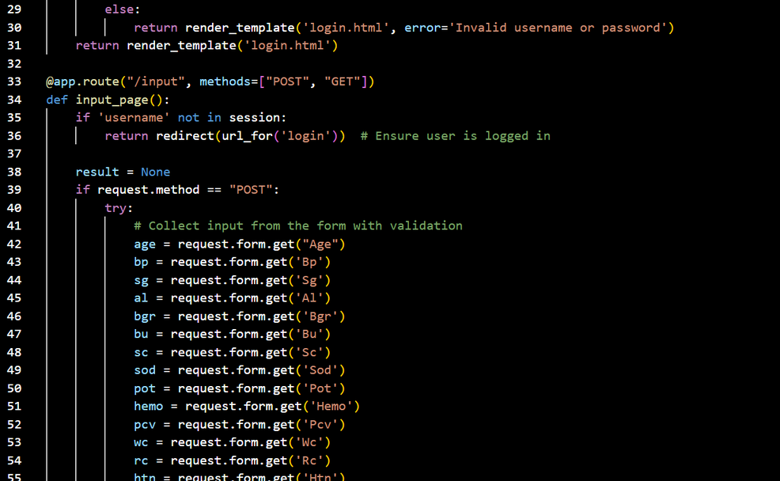
IMPLEMENTATION
Source Code

Slide 20
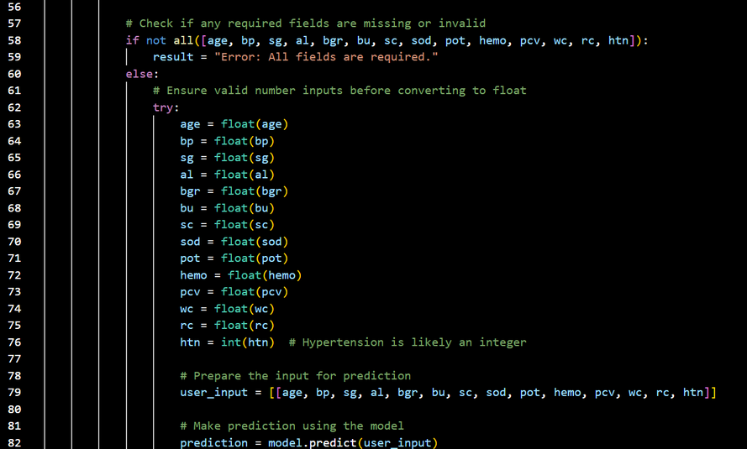
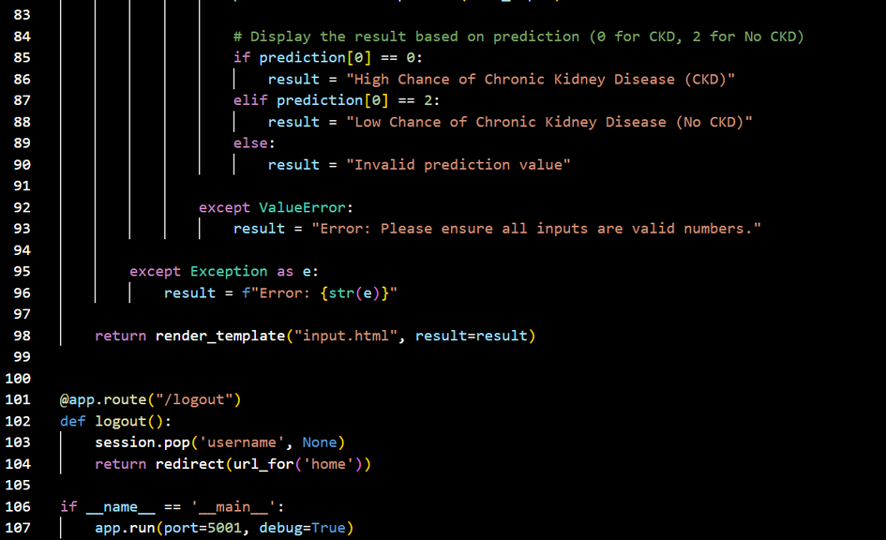
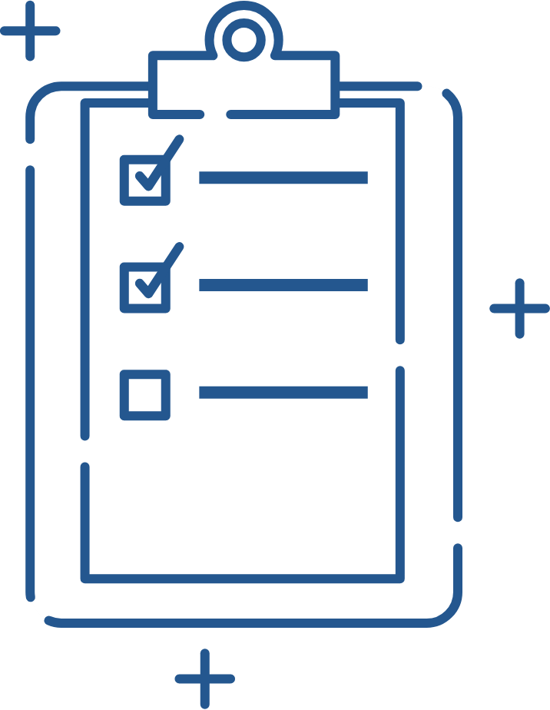
Source Code

Slide 21
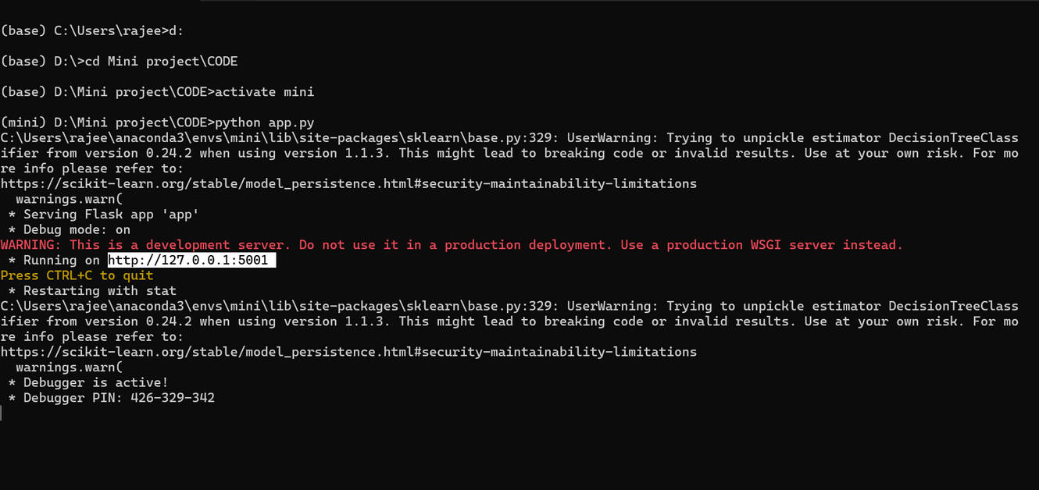

Code Execution

Slide 22
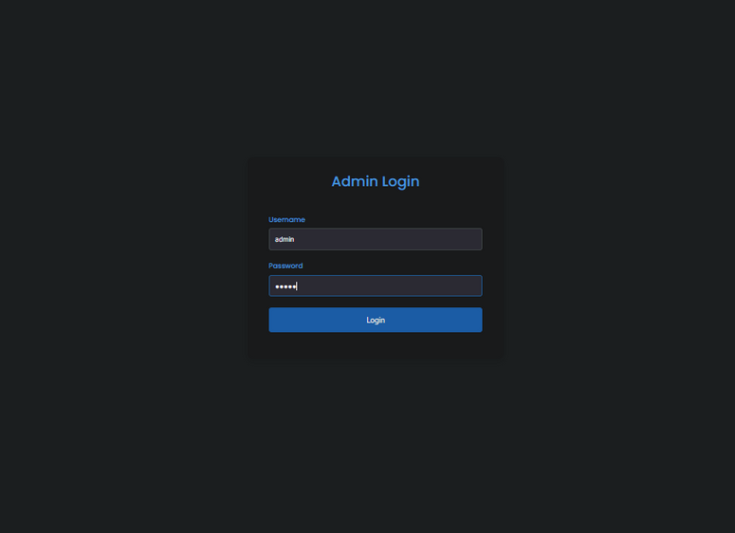
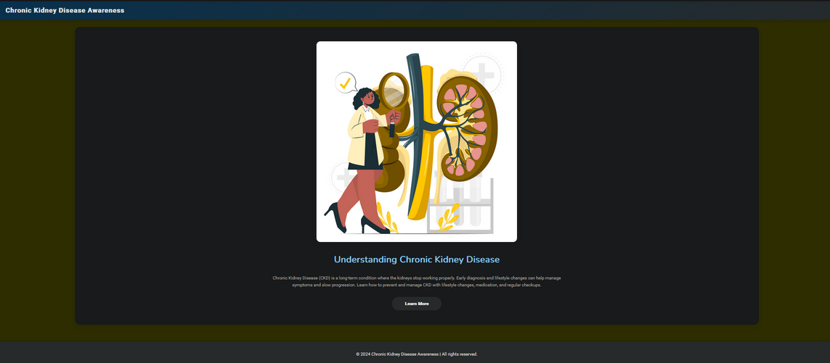
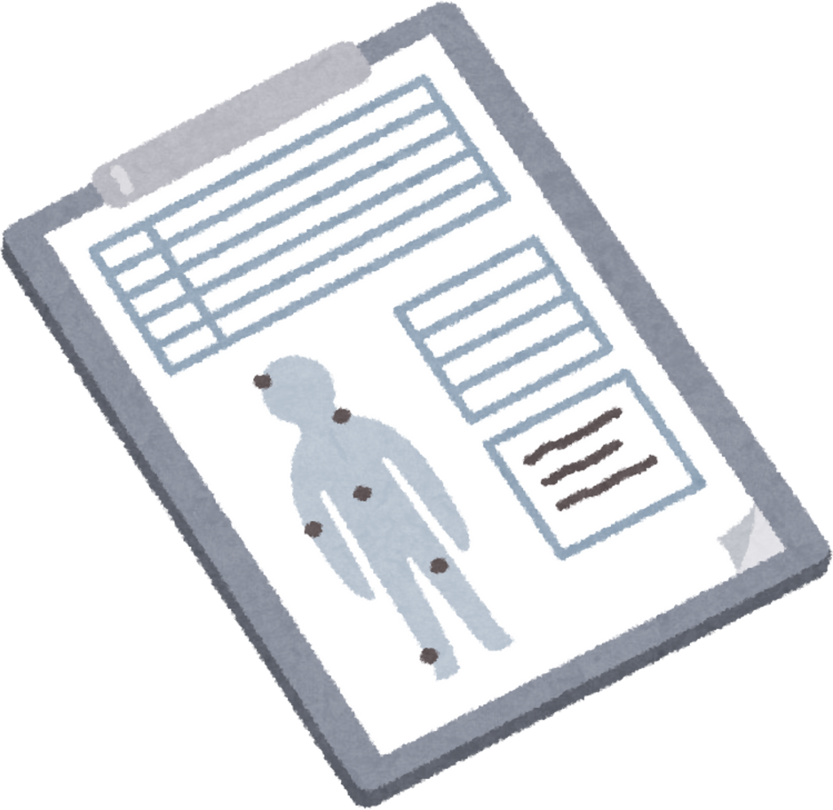
Output

Slide 23
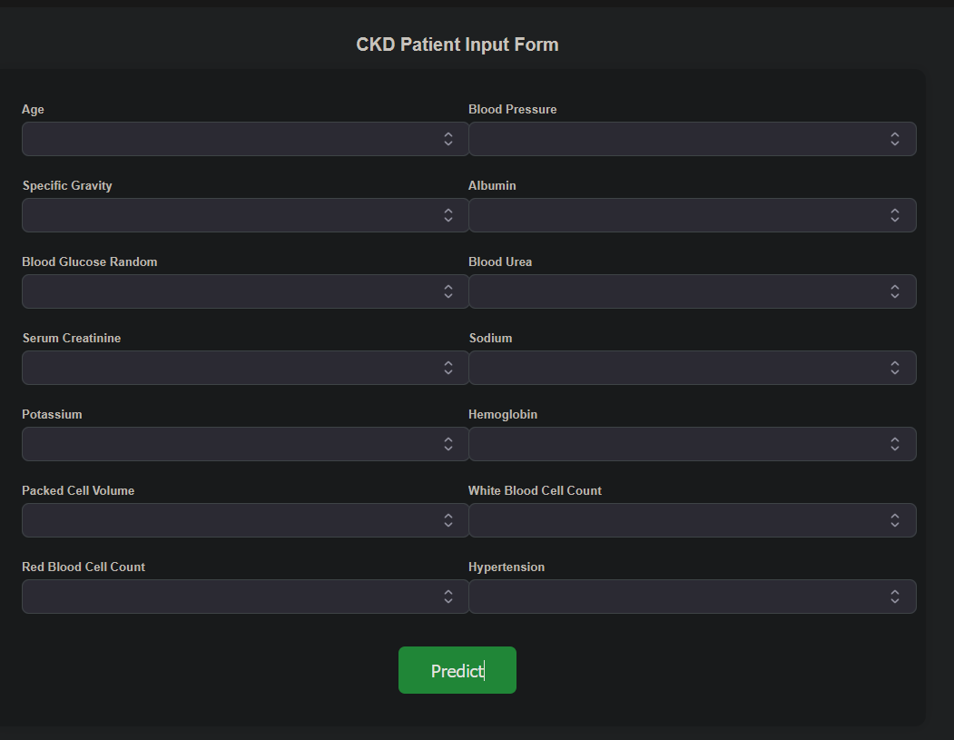
Output

Slide 24
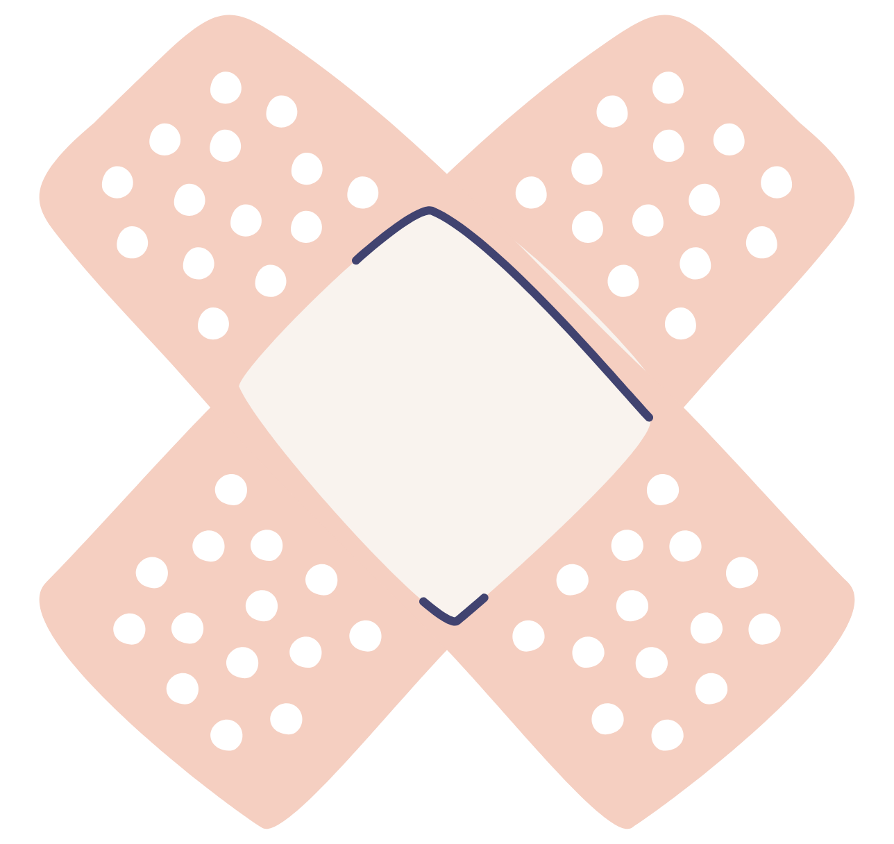
SOFTWARE TESTING
Types of Testing
Unit Testing: Tests individual modules for logic and expected outputs before integration.
Functional Testing: Verifies that functions work with valid/invalid input, proper output, and system interaction.
System Testing: Evaluates the complete system’s behavior against defined requirements.
Performance Testing: Assesses the system's responsiveness, processing speed, and stability under load.
Integration Testing : Checks interaction between modules and ensures interface correctness.
Acceptance Testing: Conducted by end-users to validate real-world functionality.
Test Plan
Defines strategies for each module, ensuring bugs are isolated early and fixed before system-wide rollout.

Slide 25

APPICATIONS
Early Detection of Chronic Kidney Disease (CKD)
Stage Classification of Kidney Disease
Dialysis and Transplant Planning
Remote Monitoring and Alerts
Reducing Diagnostic Errors
Privacy-Preserving Collaboration

Slide 26
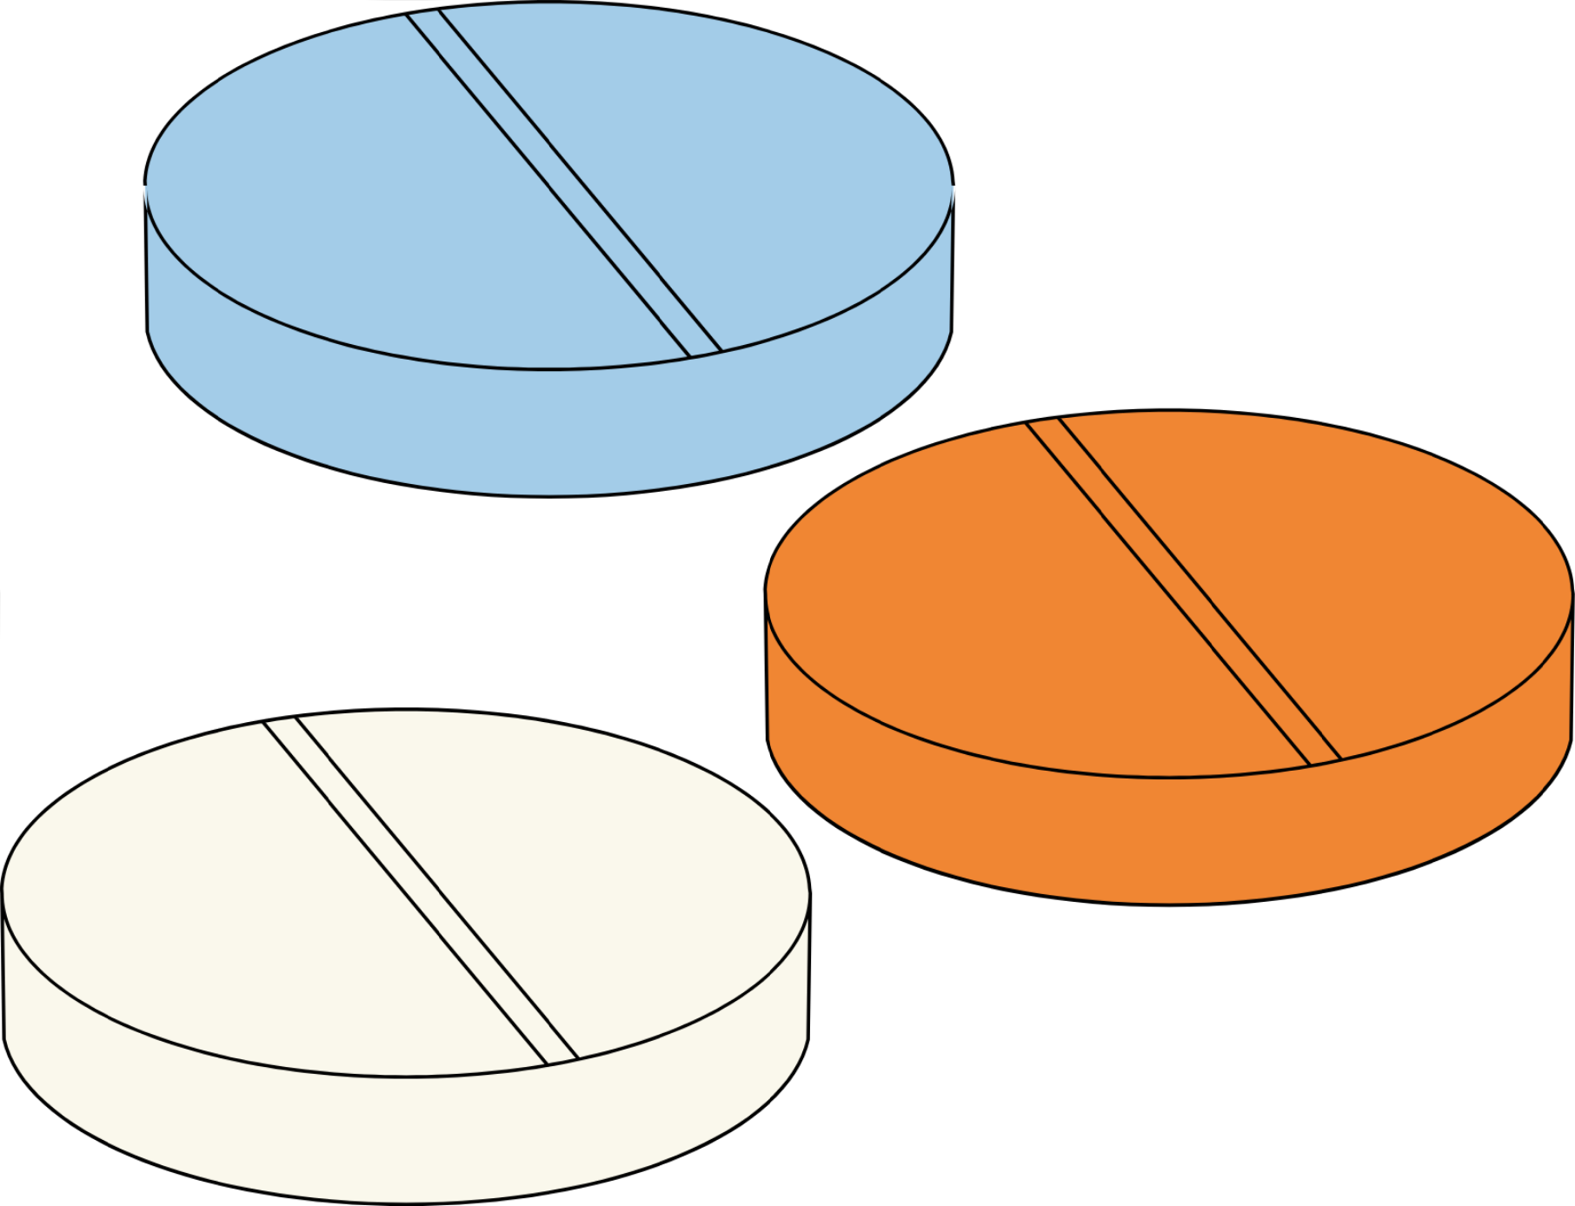
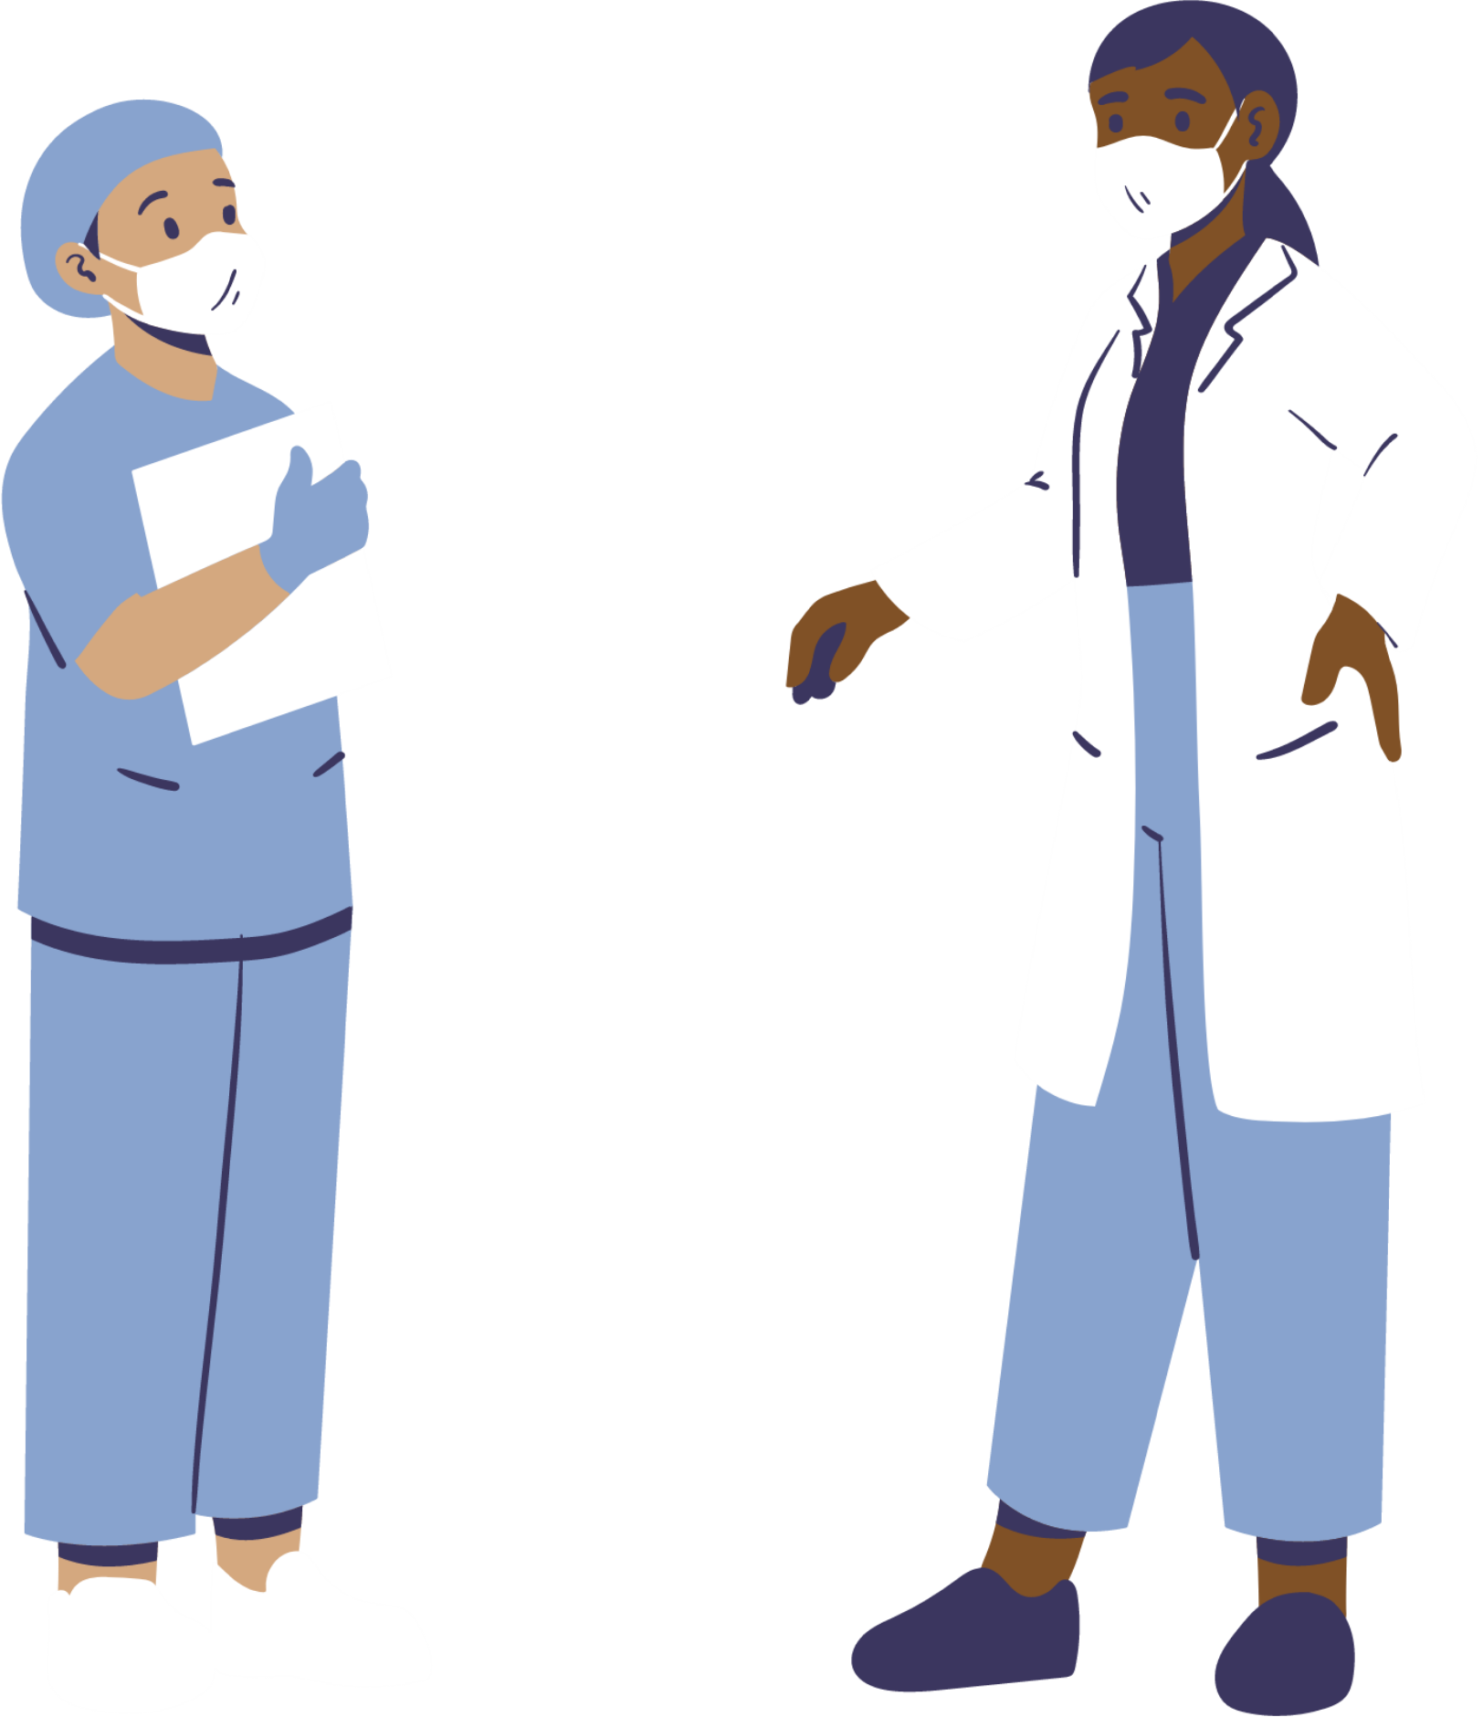
FUTURE ENHANCEMENTS
Advanced Models: Integrate ML & deep learning to detect complex patterns for higher prediction accuracy.
Expanded Data Sources: Use real-time hospital records, wearables, and diverse demographics to boost reliability.
Mobile/Cloud Deployment: Provide 24/7 access to kidney health predictions from anywhere.
IoT Integration: Connect smart devices (e.g., BP monitors, smartwatches) for live health monitoring and early alerts.
Multi-Disease Prediction: Extend model capabilities to detect related conditions like diabetes and hypertension.
Personalized Recommendations: Offer tailored lifestyle and diet suggestions based on user health data.
Voice Assistant/Chatbot: Enable interactive guidance and health explanation for better user engagement.
AI Health Companion: Evolve into a complete AI-powered tool for detection, awareness, and decision-making.

Slide 27
CONCLUSION
Summarizing key points discussed
This project highlights the power of machine learning, using Decision Tree algorithms, to predict renal health issues with speed and accuracy. By analyzing key medical factors, it supports early detection and empowers both patients and professionals.
With future enhancements like IoT and multi-disease prediction, it paves the way for smarter, AI-driven healthcare.

Slide 28
Thank you for your attention
“Empowering early diagnosis through technology not only saves lives but also shapes a healthier future.”

